Slide 1

Back propagation in neural nets
gates

Slide 2
what is back propagation (backprop)
Neural networks use weights to affect the influences of inputs (both the initial vector input x) and the hidden layers Hi.
TRAINING a NN involves adjusting/updating these weights (throughout the network) so that the output generated by the network most closely matches the expected target output.
BACKPROP is the method used to determine the updates for the weights.
The goal of backprop is to optimize the weights.

Slide 3


some math notes first

Slide 4
chain rule
In calculus, the chain rule for partial derivatives states that:
dx/dz = dx/dy * dy/dz

Slide 5
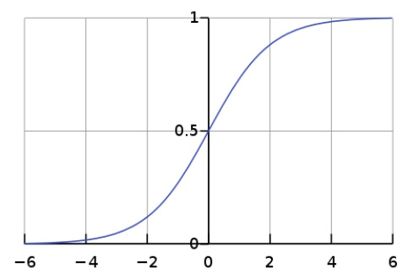
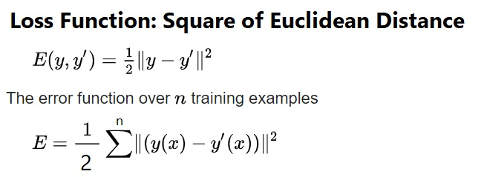

activation function: sigmoid loss function: l2 norm (MSE)
SIG(x) = 1 / (1 + e^-x)

Slide 6
the Derivative of the Sigmoid S is (S)(1 – S)
SIG(x) = 1 / (1 + e^-x)
d(SIG(x)) / dx =[ (0)(1 + e^-x) – [(0 – e^-x)(1)] ] / (1 + e^-x)^2 ##Quotient Rule
d(SIG(x)) / dx =[ e^-x / (1 + e^-x)^2 ]
d(SIG(x)) / dx =[e^-x / (1 + e^-x) (1 + e^-x)] → (e^-x) / (1 + e^-x) * 1/ (1 + e^-x)
WHICH IS: (1 – S) * (S)
NOTE: Given that we let S = 1 / (1 + e^-x)
Note that 1 – S = 1 – [1 / (1 + e^-x)]
(1 + e^-x)/(1 + e^-x) – 1/(1 + e^-x)
(1 + e^-x) – 1 / (1 + e^-x)
(e^-x) / (1 + e^-x)

Slide 7
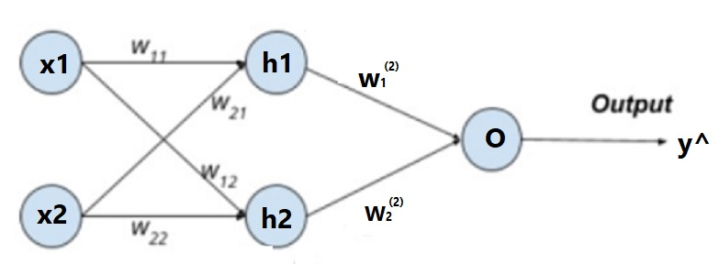
network example & basic forward equations
Loss = 1/2 (y – y^)^2
h1 = S(z11), where S is the sigmoid activation function
h2 = S(z12)
z2 = w1h1 + w2h2 + b3
y^ = S(z2)
z11 = w11x1 + w21x2 + b1
z12 = w12x1 + w22x2 + b2

Slide 8
How does changing w1 affect the loss
dL/dw1 =
What does changing w1 directly change?
Answer: It changes z(2)
dz2/dw1
2) What does changing z2 change?
Answer: It changes y^
dy^/dz2
3) What does changing y^ do?
Answer: It changes the Loss function
dL/dy^
Loss = 1/2 (y – y^)^2
z11 = w11x1 + w21x2 + b1
z12 = w12x1 + w22x2 + b2
h1 = S(z11)
h2 = S(z12)
z2 = w1h1 + w2h2 + b3
y^ = S(z2)
→ dz2/dw1 * dy^/dz2 * dL/dy^ = dL/dw1

Slide 9
derivatives
z11 = w11x1 + w21x2 + b1
z12 = w12x1 + w22x2 + b2
h1 = S(z11)
h2 = S(z12)
z2 = w1h1 + w2h2 + b3
y^ = S(z2)
dz2/dw1 * dy^/dz2 * dL/dy^ = dL/dw1
dz2/dw1 = h1
dy^/dz2 = S(z2)(1 – S(z2)) = y^(1 – y^)
Why?
We know that y^ = S
We know that the derivative of a Sigmoid S is (S)(1-S)
dL/dy^ = (y – y^)(-1)
→ h1 * y^(1 – y^) * (y – y^)(-1)
Loss = 1/2 (y – y^)^2
S is the Sigmoid
The derivative of the Sigmoid is S(1 – S)

Slide 10
proof that dy^/dz2 = = y^(1 – y^)
z2 = w1h1 + w2h2 + b3
y^ = S(z2)
dy^/dz2 = S(z2)(1 – S(z2)) = y^(1 – y^)
Why?
We know that y^ = S(z2)
We know that the derivative of a Sigmoid S is (S)(1-S)
S(z2) = 1 / (1 + e^-z2) =
We are taking the derivative wrt z2.
d(1 / (1 + e^-z2) ) =[ (0)((1 + e^-z2) + ((0)-e^-z2)(1)] / [(1 + e^-z2) ^2]
= (-e^-z2)/ [(1 + e^-z2) ^2]
= (1 – s(z2))(S(z2)) = (1 – y^)(y^)

Slide 11
what does changing w11 do?
dL/dw11 = ?
Loss = 1/2 (y – y^)^2
z11 = w11x1 + w21x2 + b1
z12 = w12x1 + w22x2 + b2
h1 = S(z11)
h2 = S(z12)
z2 = w1h1 + w2h2 + b3
y^ = S(z2)

Slide 12
what does changing w11 do?
dL/dw11 = ?
What does changing w11 directly change?
Loss = 1/2 (y – y^)^2
z11 = w11x1 + w21x2 + b1
z12 = w12x1 + w22x2 + b2
h1 = S(z11)
h2 = S(z12)
z2 = w1h1 + w2h2 + b3
y^ = S(z2)

Slide 13
what does changing w11 do?
dL/dw11 = ?
What does changing w11 directly change? It changes z1
dz1/dw11
Loss = 1/2 (y – y^)^2
z11 = w11x1 + w21x2 + b1
z12 = w12x1 + w22x2 + b2
h1 = S(z11)
h2 = S(z12)
z2 = w1h1 + w2h2 + b3
y^ = S(z2)

Slide 14
what does changing w11 do?
dL/dw11 = ?
What does changing w11 directly change? It changes z11
dz11/dw11
What does changing z11 change?
Loss = 1/2 (y – y^)^2
z11 = w11x1 + w21x2 + b1
z12 = w12x1 + w22x2 + b2
h1 = S(z11)
h2 = S(z12)
z2 = w1h1 + w2h2 + b3
y^ = S(z2)

Slide 15
what does changing w11 do?
dL/dw11 = ?
What does changing w11 directly change? It changes z11
dz11/dw11
What does changing z11 change? It changes h1
dh1/dz11
Loss = 1/2 (y – y^)^2
z11 = w11x1 + w21x2 + b1
z12 = w12x1 + w22x2 + b2
h1 = S(z11)
h2 = S(z12)
z2 = w1h1 + w2h2 + b3
y^ = S(z2)

Slide 16
what does changing w11 do?
dL/dw11 = ?
What does changing w11 directly change? It changes z11
dz11/dw11
What does changing z11 change? It changes h1
dh1/dz11
What does changing h1 change?
Loss = 1/2 (y – y^)^2
z11 = w11x1 + w21x2 + b1
z12 = w12x1 + w22x2 + b2
h1 = S(z11)
h2 = S(z12)
z2 = w1h1 + w2h2 + b3
y^ = S(z2)

Slide 17
what does changing w11 do?
dL/dw11 = ?
What does changing w11 directly change? It changes z11
dz11/dw11
What does changing z11 change? It changes h1
dh1/dz11
What does changing h1 change? It changes z2
dz2/dh1
Loss = 1/2 (y – y^)^2
z11 = w11x1 + w21x2 + b1
z12 = w12x1 + w22x2 + b2
h1 = S(z11)
h2 = S(z12)
z2 = w1h1 + w2h2 + b3
y^ = S(z2)

Slide 18
what does changing w11 do?
dL/dw11 = ?
What does changing w11 directly change? It changes z11
dz11/dw11
What does changing z11 change? It changes h1
dh1/dz11
What does changing h1 change? It changes z2
dz2/dh1
What does changing z2 change?
Loss = 1/2 (y – y^)^2
z11 = w11x1 + w21x2 + b1
z12 = w12x1 + w22x2 + b2
h1 = S(z11)
h2 = S(z12)
z2 = w1h1 + w2h2 + b3
y^ = S(z2)

Slide 19
what does changing w11 do?
dL/dw11 = ?
What does changing w11 directly change? It changes z11
dz11/dw11
What does changing z11 change? It changes h1
dh1/dz11
What does changing h1 change? It changes z2
dz2/dh1
What does changing z2 change? It changes y^
dy^/dz2
What does changing y^ change?
Loss = 1/2 (y – y^)^2
z11 = w11x1 + w21x2 + b1
z12 = w12x1 + w22x2 + b2
h1 = S(z11)
h2 = S(z12)
z2 = w1h1 + w2h2 + b3
y^ = S(z2)

Slide 20
what does changing w11 do?
dL/dw11 = ?
What does changing w11 directly change? It changes z11
dz11/dw11
What does changing z11 change? It changes h1
dh1/dz11
What does changing h1 change? It changes z2
dz2/dh1
What does changing z2 change? It changes y^
dy^/dz2
What does changing y^ change? It changes the Loss function
dL/dy^
Loss = 1/2 (y – y^)^2
z11 = w11x1 + w21x2 + b1
z12 = w12x1 + w22x2 + b2
h1 = S(z11)
h2 = S(z12)
z2 = w1h1 + w2h2 + b3
y^ = S(z2)
dL/dw11 = dz11/dw11 * dh1/dz11 * dz2/dh1 * dy^/dz2 * dL/dy^

Slide 21
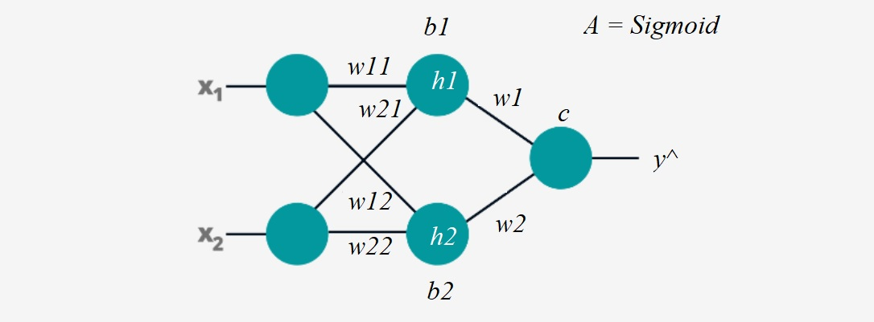
Example
X is the input matrix and will be n by c. Here, c=2 and is the number of columns of the input.
W1, the first weight matrix and is c by h, where c are the columns in X and h is the number of hidden units. Here, this is 2 by 2.
W2 is the second weight matrix and is h by o, where h here is 2 units (in the one hidden layer) and o is the number of outputs (which us 1).
b1 is the bias into h1, b2 is the bias into h2, and c is the bias into the output.
y^ is the final output
The activation function, A, is the Sigmoid.

Slide 22
4 by 2
2 by 2
1 by 2
x11 x12
x21 x22
x31 x32
x41 x42
@
w11 w12
w21 w22
+
b1 b2
X = [ [x11, x12], [x21,x22], [x31, x32], [x41, x42] ]
W1 = [ [w11, w12 ], [w21, w22] ]
W2 = [ [w1], [w2] ] this is h by 1
Z2 = H1 @ W2 + c
(4 by 2) @ (2 by 1) + (1 by 1) = (4 by 1)
where
z2i = h1*w1 + h2*w2 + c
Y^ = S(Z2)
x11*w11+ x12*w21 +b1 x11*w12 + x12*w22 + b2
x21*w11+ x22*w21 +b1 x21*w12 + x22*w22 + b2
x31*w11+ x32*w21 +b1 x31*w12 + x32*w22 + b2
x41*w11+ x42*w21 +b1 x41*w12 + x42*w22 + b2
Z1 =
H1 = S(Z1)

Slide 23
X = [ [x11, x12], [x21,x22], [x31, x32], [x41, x42] ]
W1 = [ [w11, w12 ], [w21, w22] ]
W2 = [ [w1], [w2] ] this is h by 1
Z2 = H1 @ W2 + c
(4 by 2) @ (2 by 1) + (1 by 1) = (4 by 1)
where
z2i = h1*w1 + h2*w2 + c
Y^ = S(Z2)
Loss = sum over n inputs of 1/2( y^ – y)²
x11*w11+ x12*w21 +b1 x11*w12 + x12*w22 + b2
x21*w11+ x22*w21 +b1 x21*w12 + x22*w22 + b2
x31*w11+ x32*w21 +b1 x31*w12 + x32*w22 + b2
x41*w11+ x42*w21 +b1 x41*w12 + x42*w22 + b2
Z1 =
H1 = S(Z1), where S=1/(1+e^{-x}) and dS = (s)(1 – S)
dL/dw11 dL/dw12
dL/dw21 dL/dw22
dL/dw1
dL/dw2
dL/db1
dL/db2
dL/dc

Slide 24
X = [ [x11, x12], [x21,x22], [x31, x32], [x41, x42] ]
W1 = [ [w11, w12 ], [w21, w22] ]
W2 = [ [w1], [w2] ] this is h by 1
Z2 = H1 @ W2 + c
(4 by 2) @ (2 by 1) + (1 by 1) = (4 by 1)
where
z2i = h1*w1 + h2*w2 + c
Y^ = S(Z2)
Loss = sum over n inputs of 1/2( y^ - y)²
x11*w11+ x12*w21 +b1 x11*w12 + x12*w22 + b2
x21*w11+ x22*w21 +b1 x21*w12 + x22*w22 + b2
x31*w11+ x32*w21 +b1 x31*w12 + x32*w22 + b2
x41*w11+ x42*w21 +b1 x41*w12 + x42*w22 + b2
Z1 =
H1 = S(Z1), where S=1/(1+e^{-x}) and dS = (S)(1 – S)
dL/dw1 = dz2/dw1 * dy^/dz2 * dL/dy^
= h1 * (y^)(1- y^) * (y^ - y) (remember that h1 has already been activated)
dL/dw2 = dz2/dw2 * dy^/dz2 * dL/dy^
= h2 * (y^)(1- y^) * (y^ - y)

Slide 25
X = [ [x11, x12], [x21,x22], [x31, x32], [x41, x42] ]
W1 = [ [w11, w12 ], [w21, w22] ]
W2 = [ [w1], [w2] ] this is h by 1
Z2 = H1 @ W2 + c
(4 by 2) @ (2 by 1) + (1 by 1) = (4 by 1)
where
z2 = h1*w1 + h2*w2 + c
Y^ = S(Z2)
Loss = sum over n inputs of 1/2( y^ – y)²
x11*w11+ x12*w21 +b1 x11*w12 + x12*w22 + b2
x21*w11+ x22*w21 +b1 x21*w12 + x22*w22 + b2
x31*w11+ x32*w21 +b1 x31*w12 + x32*w22 + b2
x41*w11+ x42*w21 +b1 x41*w12 + x42*w22 + b2
Z1 =
H1 = S(Z1), where S=1/(1+e^{-x}) and dS = (s)(1 – S)
dL/dc = dz2/dc * dy^/dz2 * dL/dy^
= 1 * (y^)(1 – y^) * (y^ – y)

Slide 26
X = [ [x11, x12], [x21,x22], [x31, x32], [x41, x42] ]
W1 = [ [w11, w12 ], [w21, w22] ]
W2 = [ [w1], [w2] ] this is h by 1
Z2 = H1 @ W2 + c
(4 by 2) @ (2 by 1) + (1 by 1) = (4 by 1)
where
z2 = h1*w1 + h2*w2 + c
Y^ = S(Z2)
Loss = sum over n inputs of 1/2( y^ – y)²
z_1 1=x11*w11+ x12*w21 +b1 z_1 2=x11*w12 + x12*w22 + b2
x21*w11+ x22*w21 +b1 x21*w12 + x22*w22 + b2
x31*w11+ x32*w21 +b1 x31*w12 + x32*w22 + b2
x41*w11+ x42*w21 +b1 x41*w12 + x42*w22 + b2
Z1 =
H1 = S(Z1), where S=1/(1+e^{-x}) and dS = (s)(1 – S)
Recall
h1 = S(z_1 1)
h2 = S(z_1 2)
dL/dw11 = dz_1 1/dw11 * dh1/dz_1 1 * dz2/dh1 * dy^/dz2 * dL/dy^
= x11 * (h1)(1 – h1) * w1 * (y^)(1 – y^) * (y^- y)
dL/dw21
dL/dw12
dL/dw22

Slide 27
X = [ [x11, x12], [x21,x22], [x31, x32], [x41, x42] ]
W1 = [ [w11, w12 ], [w21, w22] ]
W2 = [ [w1], [w2] ] this is h by 1
Z2 = H1 @ W2 + c
(4 by 2) @ (2 by 1) + (1 by 1) = (4 by 1)
where
z2 = h1*w1 + h2*w2 + c
Y^ = S(Z2)
Loss = sum over n inputs of 1/2( y^ – y)²
z_1 1=x11*w11+ x12*w21 +b1 z_1 2=x11*w12 + x12*w22 + b2
x21*w11+ x22*w21 +b1 x21*w12 + x22*w22 + b2
x31*w11+ x32*w21 +b1 x31*w12 + x32*w22 + b2
x41*w11+ x42*w21 +b1 x41*w12 + x42*w22 + b2
Z1 =
H1 = S(Z1), where S=1/(1+e^{-x}) and dS = (s)(1 – S)
Recall
h1 = S(z_1 1)
h2 = S(z_1 2)
dL/dw11 = dz_1 1/dw11 * dh1/dz_1 1 * dz2/dh1 * dy^/dz2 * dL/dy^
= x11 * (h1)(1 – h1) * w1 * (y^)(1 – y^) * (y^- y)
dL/dw21 = dz_1 1/dw21 * dh1/dz_1 1 * dz2/dh1 * dy^/dz2 * dL/dy^
= x12 * (h1)(1 – h1) * w1 * (y^)(1 – y^) * (y^- y)
dL/dw12
dL/dw22

Slide 28
X = [ [x11, x12], [x21,x22], [x31, x32], [x41, x42] ]
W1 = [ [w11, w12 ], [w21, w22] ]
W2 = [ [w1], [w2] ] this is h by 1
Z2 = H1 @ W2 + c
(4 by 2) @ (2 by 1) + (1 by 1) = (4 by 1)
where
z2 = h1*w1 + h2*w2 + c
Y^ = S(Z2)
Loss = sum over n inputs of 1/2( y^ – y)²
z_1 1=x11*w11+ x12*w21 +b1 z_1 2=x11*w12 + x12*w22 + b2
x21*w11+ x22*w21 +b1 x21*w12 + x22*w22 + b2
x31*w11+ x32*w21 +b1 x31*w12 + x32*w22 + b2
x41*w11+ x42*w21 +b1 x41*w12 + x42*w22 + b2
Z1 =
H1 = S(Z1), where S=1/(1+e^{-x}) and dS = (s)(1 – S)
Recall
h1 = S(z_1 1)
h2 = S(z_1 2)
dL/dw11 = dz_1 1/dw11 * dh1/dz_1 1 * dz2/dh1 * dy^/dz2 * dL/dy^
= x11 * (h1)(1 – h1) * w1 * (y^)(1 – y^) * (y^- y)
dL/dw21 = dz_1 1/dw21 * dh1/dz_1 1 * dz2/dh1 * dy^/dz2 * dL/dy^
= x12 * (h1)(1 – h1) * w1 * (y^)(1 – y^) * (y^- y)
dL/dw12 = dz_1 2/dw12 * dh2/dz_1 2 * dz2/dh2 * dy^/dz2 * dL/dy^
= x11 * (h2)(1 – h2) * w2 * (y^)(1 – y^) * (y^- y)
dL/dw22

Slide 29
X = [ [x11, x12], [x21,x22], [x31, x32], [x41, x42] ]
W1 = [ [w11, w12 ], [w21, w22] ]
W2 = [ [w1], [w2] ] this is h by 1
Z2 = H1 @ W2 + c
(4 by 2) @ (2 by 1) + (1 by 1) = (4 by 1)
where
z2 = h1*w1 + h2*w2 + c
Y^ = S(Z2)
Loss = sum over n inputs of 1/2( y^ – y)²
z_1 1=x11*w11+ x12*w21 +b1 z_1 2=x11*w12 + x12*w22 + b2
x21*w11+ x22*w21 +b1 x21*w12 + x22*w22 + b2
x31*w11+ x32*w21 +b1 x31*w12 + x32*w22 + b2
x41*w11+ x42*w21 +b1 x41*w12 + x42*w22 + b2
Z1 =
H1 = S(Z1), where S=1/(1+e^{-x}) and dS = (s)(1 – S)
Recall
h1 = S(z_1 1)
h2 = S(z_1 2)
dL/dw11 = dz_1 1/dw11 * dh1/dz_1 1 * dz2/dh1 * dy^/dz2 * dL/dy^
= x11 * (h1)(1 – h1) * w1 * (y^)(1 – y^) * (y^- y)
dL/dw21 = dz_1 1/dw21 * dh1/dz_1 1 * dz2/dh1 * dy^/dz2 * dL/dy^
= x12 * (h1)(1 – h1) * w1 * (y^)(1 – y^) * (y^- y)
dL/dw12 = dz_1 2/dw12 * dh2/dz_1 2 * dz2/dh2 * dy^/dz2 * dL/dy^
= x11 * (h2)(1 – h2) * w2 * (y^)(1 – y^) * (y^- y)
dL/dw22= dz_1 2/dw22 * dh2/dz_1 2 * dz2/dh2 * dy^/dz2 * dL/dy^
= x12 * (h2)(1 – h2) * w2 * (y^)(1 – y^) * (y^- y)

Slide 30
X = [ [x11, x12], [x21,x22], [x31, x32], [x41, x42] ]
W1 = [ [w11, w12 ], [w21, w22] ]
W2 = [ [w1], [w2] ] this is h by 1
Z2 = H1 @ W2 + c
(4 by 2) @ (2 by 1) + (1 by 1) = (4 by 1)
where
z2 = h1*w1 + h2*w2 + c
Y^ = S(Z2)
Loss = sum over n inputs of 1/2( y^ – y)²
z_1 1=x11*w11+ x12*w21 +b1 z_1 2=x11*w12 + x12*w22 + b2
x21*w11+ x22*w21 +b1 x21*w12 + x22*w22 + b2
x31*w11+ x32*w21 +b1 x31*w12 + x32*w22 + b2
x41*w11+ x42*w21 +b1 x41*w12 + x42*w22 + b2
Z1 =
H1 = S(Z1), where S=1/(1+e^{-x}) and dS = (s)(1 – S)
Recall
h1 = S(z_1 1)
h2 = S(z_1 2)
dL/db1 = dz_1 1/db1 * dh1/dz_1 1 * dz2/dh1 * dy^/dz2 * dL/dy^
= 1 * (h1)(1 – h1) * w1 * (y^)(1 – y^) * (y^- y)
dL/db2 =

Slide 31
X = [ [x11, x12], [x21,x22], [x31, x32], [x41, x42] ]
W1 = [ [w11, w12 ], [w21, w22] ]
W2 = [ [w1], [w2] ] this is h by 1
Z2 = H1 @ W2 + c
(4 by 2) @ (2 by 1) + (1 by 1) = (4 by 1)
where
z2 = h1*w1 + h2*w2 + c
Y^ = S(Z2)
Loss = sum over n inputs of 1/2( y^ – y)²
z_1 1=x11*w11+ x12*w21 +b1 z_1 2=x11*w12 + x12*w22 + b2
x21*w11+ x22*w21 +b1 x21*w12 + x22*w22 + b2
x31*w11+ x32*w21 +b1 x31*w12 + x32*w22 + b2
x41*w11+ x42*w21 +b1 x41*w12 + x42*w22 + b2
Z1 =
H1 = S(Z1), where S=1/(1+e^{-x}) and dS = (S)(1 – S)
Recall
h1 = S(z_1 1)
h2 = S(z_1 2)
dL/db1 = dz_1 1/db1 * dh1/dz_1 1 * dz2/dh1 * dy^/dz2 * dL/dy^
= 1 * (h1)(1 – h1) * w1 * (y^)(1 – y^) * (y^- y)
dL/db2 =dz_1 2/db2 * dh2/dz_1 2 * dz2/dh2 * dy^/dz2 * dL/dy^
= 1 * (h2)(1 – h2) * w2 * (y^)(1 – y^) * (y^- y)

Slide 32
dL/dw11 = dz_1 1/dw11 * dh1/dz_1 1 * dz2/dh1 * dy^/dz2 * dL/dy^
= x11 * (h1)(1 – h1) * w1 * (y^)(1 – y^) * (y^- y)
dL/dw21 = dz_1 1/dw21 * dh1/dz_1 1 * dz2/dh1 * dy^/dz2 * dL/dy^
= x12 * (h1)(1 – h1) * w1 * (y^)(1 – y^) * (y^- y)
dL/db1 = dz_1 1/db1 * dh1/dz_1 1 * dz2/dh1 * dy^/dz2 * dL/dy^
= 1 * (h1)(1 – h1) * w1 * (y^)(1 – y^) * (y^- y)
dL/dw12 = dz_1 2/dw12 * dh2/dz_1 2 * dz2/dh2 * dy^/dz2 * dL/dy^
= x11 * (h2)(1 – h2) * w2 * (y^)(1 – y^) * (y^- y)
dL/dw22= dz_1 2/dw22 * dh2/dz_1 2 * dz2/dh2 * dy^/dz2 * dL/dy^
= x12 * (h2)(1 – h2) * w2 * (y^)(1 – y^) * (y^- y)
dL/db2 =dz_1 2/db2 * dh2/dz_1 2 * dz2/dh2 * dy^/dz2 * dL/dy^
= 1 * (h2)(1 – h2) * w2 * (y^)(1 – y^) * (y^- y)
dL/dw1 = dz2/dw1 * dy^/dz2 * dL/dy^
= h1 * (y^)(1- y^) * (y^ - y)
dL/dw2 = dz2/dw2 * dy^/dz2 * dL/dy^
= h2 * (y^)(1- y^) * (y^ - y)
dL/dc = dz2/dc * dy^/dz2 * dL/dy^
= 1 * (y^)(1 – y^) * (y – y^)

Slide 33
dL/dw11 = dz_1 1/dw11 * dh1/dz_1 1 * dz2/dh1 * dy^/dz2 * dL/dy^
= x11 * (h1)(1 – h1) * w1 * y^D_Error
dL/dw21 = dz_1 1/dw21 * dh1/dz_1 1 * dz2/dh1 * dy^/dz2 * dL/dy^
= x12 * (h1)(1 – h1) * w1 * y^D_Error
dL/db1 = dz_1 1/db1 * dh1/dz_1 1 * dz2/dh1 * dy^/dz2 * dL/dy^
= 1 * (h1)(1 – h1) * w1 * y^D_Error
dL/dw12 = dz_1 2/dw12 * dh2/dz_1 2 * dz2/dh2 * dy^/dz2 * dL/dy^
= x11 * (h2)(1 – h2) * w2 * y^D_Error
dL/dw22= dz_1 2/dw22 * dh2/dz_1 2 * dz2/dh2 * dy^/dz2 * dL/dy^
= x12 * (h2)(1 – h2) * w2 * y^D_Error
Call this y^_error
(y^- y)
Call this y^D_Error
(y^)(1 – y^) (y^- y)
dL/db2 =dz_1 2/db2 * dh2/dz_1 2 * dz2/dh2 * dy^/dz2 * dL/dy^
= 1 * (h2)(1 – h2) * w2 * y^D_Error
dL/dw1 = dz2/dw1 * dy^/dz2 * dL/dy^
= h1 * y^D_Error
dL/dw2 = dz2/dw2 * dy^/dz2 * dL/dy^
= h2 * y^D_Error
dL/dc = dz2/dc * dy^/dz2 * dL/dy^
= 1 * y^D_Error

Slide 34
The H’s
Z1=
S(Z1) = H1=
dH1 =
x11*w11+ x12*w21 +b1 x11*w12 + x12*w22 + b2
x21*w11+ x22*w21 +b1 x21*w12 + x22*w22 + b2
x31*w11+ x32*w21 +b1 x31*w12 + x32*w22 + b2
x41*w11+ x42*w21 +b1 x41*w12 + x42*w22 + b2
h11 h12
h21 h22
h31 h32
h41 h42
h11(1 – h11) h12(1 – h12)
h21(1 – h21) h22(1 – h22)
h31(1 – h31) h32(1 – h32)
h41(1 – h41) h42(1 – h42)

Slide 35
Step 1:thinking about the code
def Sig(value, dS=False):
if (dS == True):
return value * (1 – value)
return 1/(1 + np.exp(-value))

